Slide 1

AUTOMATED SCREENING FOR DETECTION AND ASSESSMENT OF GLAUCOMA PROGRESSION USING FUNDUS IMAGES
Guided by
Dr. Jayanthi Ganapathy, Assistant Professor, Sri Ramachandra Faculty of Engineering and Technology
Dr. John Davis Akkara , Ophthalmologist/ Eye Surgeon, Sri Ramachandra University
SRI RAMACHANDRA FACULTY OF ENGINEERING & TECHNOLOGY
CHENNAI, INDIA

Slide 2
TEAM MEMBERS
Karan V - SRET
Rajalakshmanan - SRET
Sathishkumar M - SRET
Thiruvengadam S - SRET
Vishal L - SRET

Slide 3
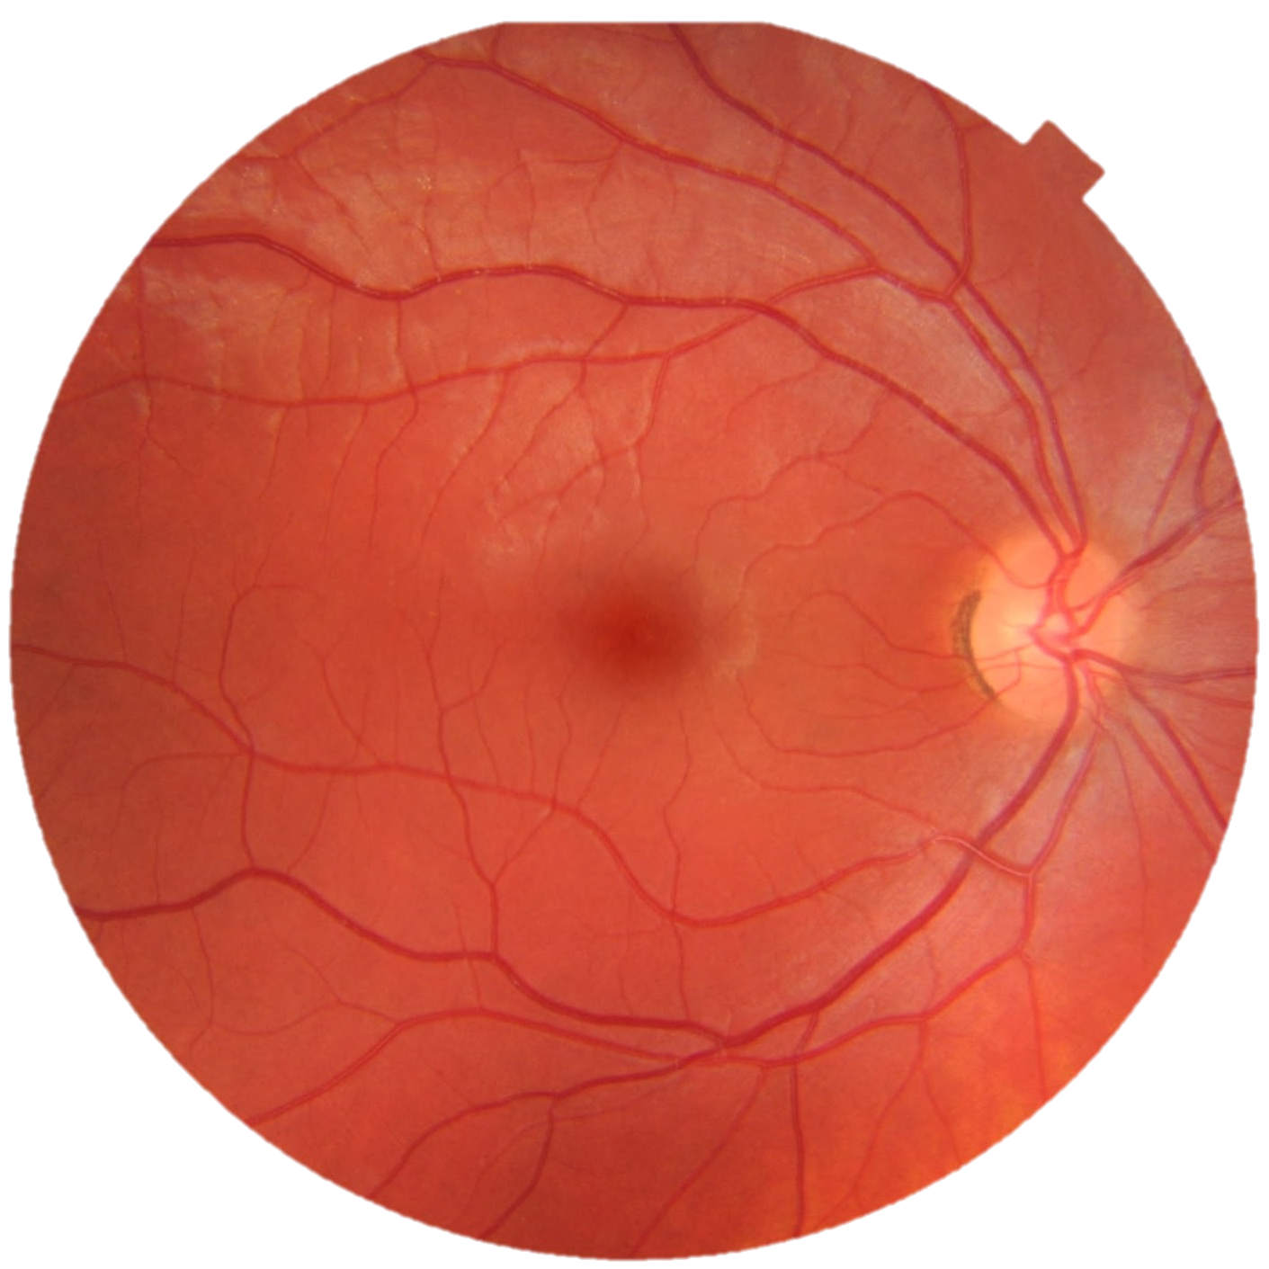
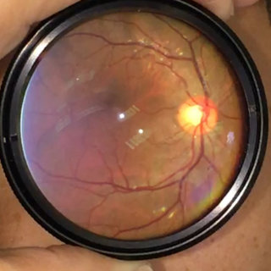
GLAUCOMA
Glaucoma is a group of eye diseases that can cause vision loss and blindness by damaging the optic nerve in the eye usually due to excessively high intraocular pressure (IOP)
Fundus camera
Smartphone camera

Slide 4
CUP DISC EXTRACTION
The dataset with 101 images : 50 training and 51 testing images is annotated with Optic Disc (OD), Optic Cup (OC) boundaries and Cup to disc Ratio (CDR) Values.
UNET model is trained with mask of OD, OC of the fundus image annotated and it gives
Accuracy - 89%
Jacquard score (IOU) - 0.81

Slide 5
GLAUCOMA CLASSIFIER
The dataset with around 1200 images of the posterior pole of the Messidor database with a 45 degree field of view is used for training
The RESNET model weights is used for modelling with 80:20 train test ratio and achieved
Accuracy – 94 %
Precision – 0.98
Recall – 0.86

Slide 6
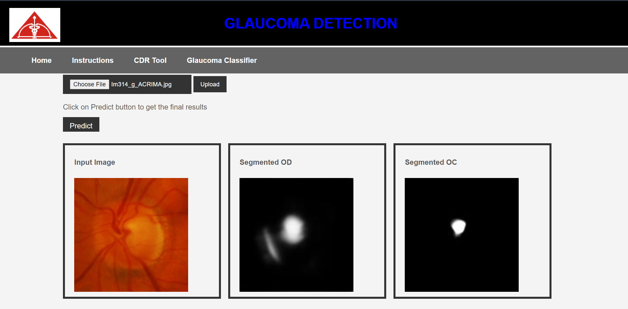
WEB APP LOOKUP
View the demo here - https://youtu.be/0Ms8UnM8JYI

Slide 7
FUTURE WORKS
We aim to assess the progression of glaucoma using Cup to disc ratio by segmenting cup and the optic disk from fundus images.
Also to implement segmentation of optic nerves and classify based on the Optic Nerve thickness
We are also working on segmentation & Classification of Smart Phone Fundus images which is Simple and a Inexpensive Technique

Slide 8
THANK YOU

